Slide 1
EDA CASE STUDY SUBMISSION
Group Name:
Aryama Ray
Rupali Hangekar
Alan Jose
Aryan Patel

Slide 2
Abstract
The objective of EDA is to highlight the factors which can identify probable defaulter customers who might lead the consumer finance company to a financial loss. So our key focus is on Financial loss type of risk.
Our data set does not have record for rejected loans. Hence analysis has been performed on Loan Accepted transactional history data.
Loan accepted transactions have three different loan status Full Paid, Current and Charged Off. Analysis has been performed to find out the factors in which cases Charged Off rate is high as Charged Off status signifies loan defaulters.
Few assumptions were made based on the input dataset for accepted loan transactions.
Scope of analysis has been restricted in highlighting six driving factors to identify probable defaulters.
EDA has been performed after cleaning and manipulating the input data set. We have performed univariate, bivariate and multivariate analysis to find out six driving factors.
Analysis concludes that the following fields to be driving factors :
Consumer attribute: Purpose , Employment Length, Customer’s State
Loan attribute: Earliest Credit Line, Grade/Sub-grade, borrowing capacity which is derived variable from percentage of installment per monthly income

Slide 3
Assumptions
Before starting the analysis we made few assumptions based on the input data set.
We assumed that scope of our analysis is for publicly available policies from the consumer finance company as the data in hand is for policy code 1.
All the loan applications have been made for individual applicants. Analysis on loan application from joint applicant is out of scope.
All the loan applications are made with fractional initial listing status.
For all the loan applications no payment plan has been put in place.
Our analysis dataset does not have any accounts on which the borrower is now delinquent.
There is no such record in scope of analysis which has non zero past-due amount owed for the accounts on which the borrower is now delinquent.
There is no incident of charge off within 12 months.
Number of collections in 12 months excluding medical collections is zero for the dataset in scope.
Also, we assumed tax liens is zero for all the records in scope.

Slide 4
Flow of Analysis
Data Cleaning
Identify unique keys
EDA
Resolving data quality issue
We started with data clean up and resolving data quality issues.
Removed all fields which are having only NA values.
Removed fields on which we made assumptions as they are having single values.
All the blank values in the data set have been replaced with NA values.
There are three variables - collections_12_mths_ex_med, chargeoff_within_12_mths and tax_liens , which are holding single values all through out for 99.9 % records and NA values for the rest. Hence we include them in assumptions and removed them from the scope of analysis.
Identified data quality issues and rectified them.
There are some data quality issues in monitory data fields like few monitory values have more than 9 decimal places. These were rounded to 2 decimal place.
Converted all the dates into same date format for ease of analysis.
Since URL and description fields do not provide any useful data, we kept them out of scope.
Few outliers were observed during analysis on derived monthly income variable. Excluded those outlier values.
Uniqueness of key value fields were verified – id and member id. These are unique for the dataset.
EDA has been performed on the cleaned up dataset. Performed univariate, bivariate analysis and derived metrics on categorical and continuous data. Also, for testing purpose, correlation matrix has been deduced for continuous variables to get the insight of the data.

Slide 5
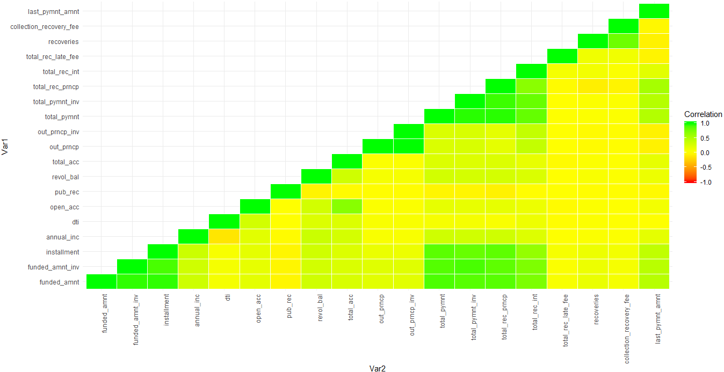
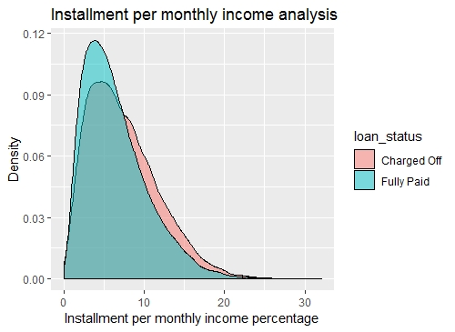
Analysis on Installment, Monthly income on Loan Status
Correlation matrix for continuous variables, shows that there exists correlation between multiple variables.
Due to limitation of the scope of analysis, analysis has been performed on only few variables.
Correlation plot shows that there exists positive correlation between installment and annual income. From annual income we have derived monthly income and thereafter derived installment per monthly income percentage to check their effect on Loan status.
Analysis shows that if this percentage reaches around 10% and above , there is a chance for the borrowers getting defaulted.

Slide 6
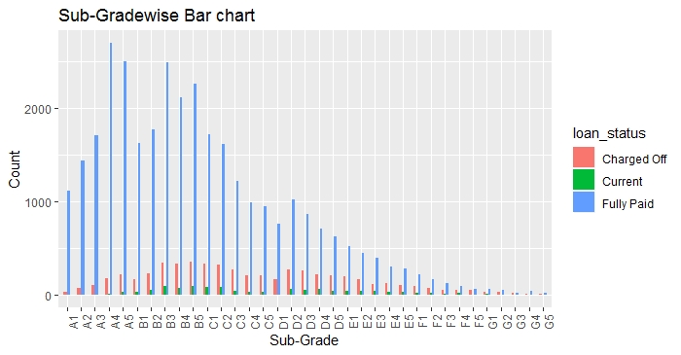
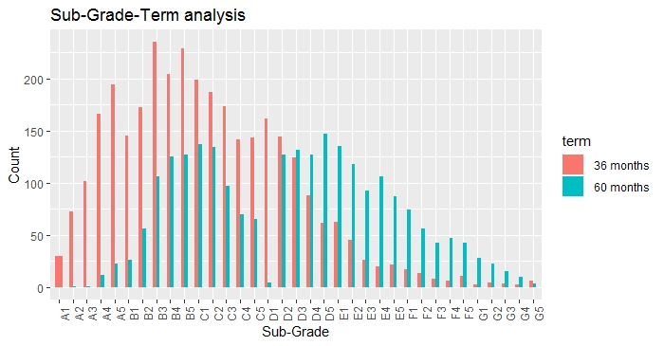
Sub-Grade and Loan Term attribute Analysis on Loan Status
Borrowers are segregated into 7 grades : A-G and each grade is sub-divided into 5 sub-grades.
Since sub-grades gives us more granular analysis , we have performed analysis on sub grades here.
First analysis indicates that sub-grades B3 has a spike in number of loans which are in status of Charged Off and again at D2 there is a spike for charged off status which then subsides gradually thereafter.
Second analysis shows us more effective insights as we considered two different loan terms and only those loans data which are in Charged off status here. For loan term of 36 months and sub-grade B3 there is a increase in number of loans which are in status of charged off , and for loan term 60 months and sub-grade D2 there is a huge spike in charged off rates.

Slide 7
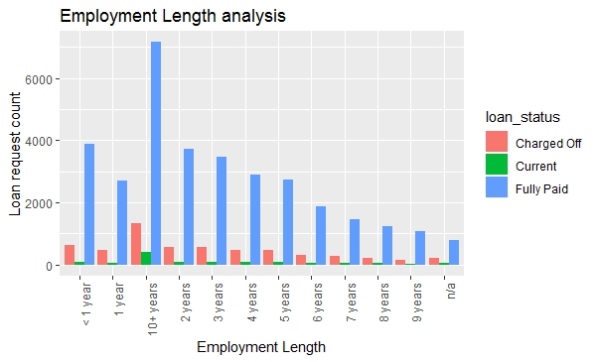
Employment Length attribute analysis on Loan Status
Univariate analysis has been performed on Employment length and we analyzed for different loan status.
This analysis indicates that the borrowers who are having 10+ years of experience, there is a high chance of loans getting charged off than that of the rest of the borrowers.
Though it is to be noticed that Fully Paid rate is also high for this segment borrowers.
For 10+ years of experienced borrowers, loan payment tenure gets reduced as their retirement age approaches, it could led borrowers being defaulter.

Slide 8
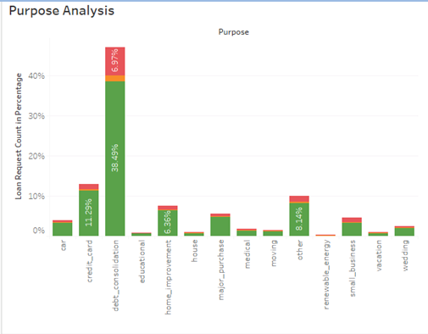
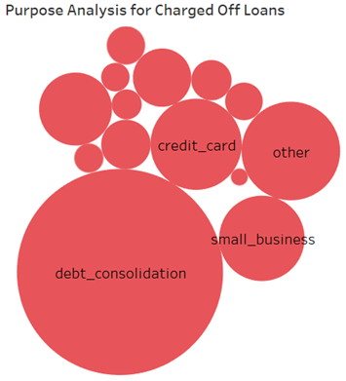

Purpose attribute analysis on Loan Status
Purpose is a consumer attribute and analysis shows that it could a driving factor to predict defaulters.
Charged off rate is high for the loans taken for debt consolidation purpose.

Slide 9
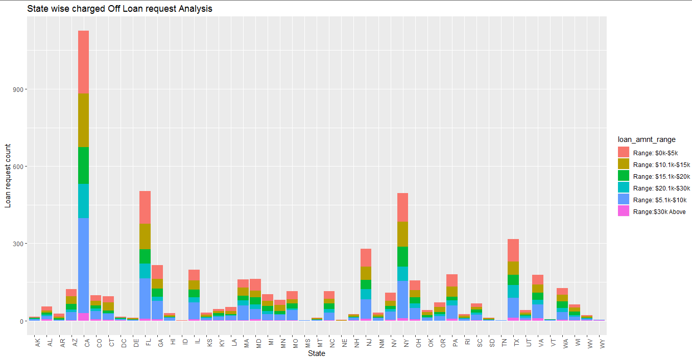
Analysis on Borrower’s State
Analysis has been performed on borrowers’ state. We have segmented approved loan request amount in six range segments.
Analysis is showing that for California state. number of loan request is high. For this state Charged Off loan counts are higher than the other states and there are more instances of loan request of amount in the range of $5.1K to $10K gets charged off.

Slide 10
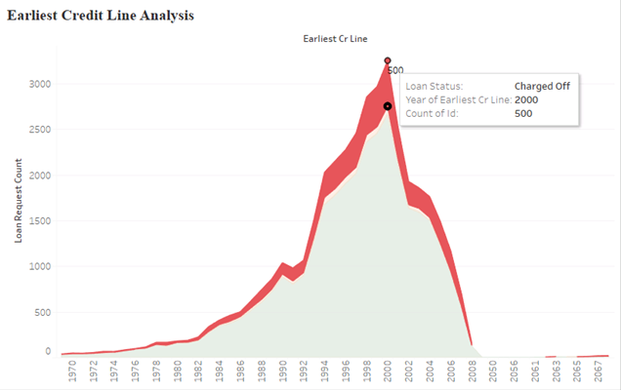
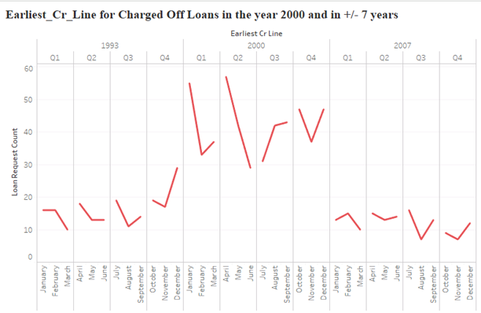

Earliest Credit Line Analysis
Univariate analysis has been performed on Earliest Credit Line, which is assumed to be based borrower’s age.
The analysis shows there is a spike in charged off loan count for earliest credit line opened around the year 2000.

Slide 11
Summary
Based on our analysis we conclude the following attributes to be driving factors to identify loan defaulters.
Installment amount and monthly income (i.e annual income)
Borrower’s State
Earliest Credit Line
Sub-grade and Loan Term
Employment Length
Purpose of Loan

